Slide 1
LENDING CASE STUDY
EDA CASE STUDY
Shivroop Patil

Slide 2
CONTENT
Business Objective
Problem statement
EDA analysis work flow
Data Analysis & Data Visualization
Univariate analysis & Bivariate analysis
Multivariate analysis
Conclusion

Slide 3
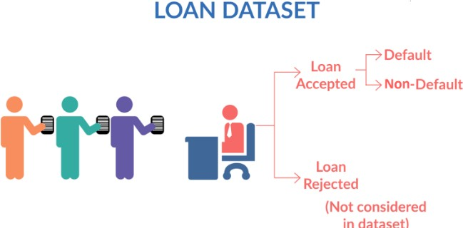
Objectives
The goal is to identify these risky loan applicants, then such loans can be reduced thereby cutting down the amount of credit loss. Identification of such applicants using EDA using the given dataset, is the aim of this case study.
If one is able to identify these risky loan applicants, then such loans can be reduced thereby cutting down the
amount of credit loss. Identification of such applicants using EDA is the aim of this case study.
In other words, the company wants to understand the driving factors (or driver variables) behind loan default,
i.e. the variables which are strong indicators of default. The company can utilize this knowledge for its portfolio and risk assessment.

Slide 4
Data Understanding
The data given below contains the information about past loan applicants and whether they ‘defaulted’ or not. The aim is to identify patterns which indicate if a person is likely to default, which may be used for taking actions such as denying the loan, reducing the amount of loan, lending (to risky applicants) at a higher interest rate, etc.
The dataset reflects loans post approval, thus does not represent any information on the rejection criteria
process
Overall objective will be to observe key leading indicators (driver variables) in the dataset, which contribute to defaulters
Use the analysis as a the foundation of the hypothesis
The overall loan process is represented by three steps
Potential borrower requests for loan amount (loan_amnt)
The approver approves/rejects an amount based on past history/risk (funded_amnt) The final amount offered as loan by the investor (funded_amnt_inv)
Data Understanding Domain Leading Attribute
Loan Status - Key Leading Attribute (loan_status). The column has three distinct values
Fully-Paid - The customer has successfully paid the loan Charged-Off - The customer is "Charged-Off" is has "Defaulted"
Current - These customers, the loan is currently in progress and cannot contribute to conclusive evidence if the customer will default of pay in future
For the given case study, "Current" status rows will be ignored

Slide 5
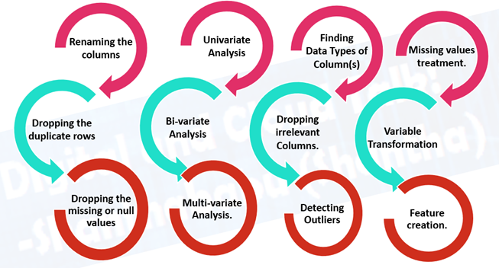
EDA ANALYSIS WORK FLOW

Slide 6
PROBLEM STATEMENT
The data given contains information about past loan applicants and whether they ‘defaulted’. The aim is to identify patterns indicating that a person is likely to default, which may be used to deny the loan, reduce the loan amount, lend (to risky applicants) at a higher interest rate, etc.
In this case study, you will use EDA to understand how consumer attributes and loan attributes influence the tendency of defaulting.
In other words, the company wants to understand the driving factors (or driver variables) behind loan default, i.e., the variables which are strong indicators of default. The company can utilize this knowledge for its portfolio and risk assessment.

Slide 7
DATA ANALYSIS & DATA VISULIZATION
Data Analysis
Univariate analysis
Bivariate analysis
Multivariate analysis
In this analysis they have done three types of graphs
count vs features (univariate)
loan status vs features (bivariate)
loan status vs one variable column vs second variable column by taking hue (multivariate analysis)

Slide 8
UNIVARITA & BIVARIATE ANALYSIS
Univariate Analysis
explores each variable in a data set, separately. It looks at the range of values, as well as the central tendency of the values. It describes the pattern of response to the variable. It describes each variable on its own. Descriptive statistics describe and summarize data.
Bivariate Analysis
Bi means two and variate means variable. Collectively, Bivariate analysis refers to the exploratory data analysis between two variables. The variables can be either numeric or categorical. Bivariate analysis helps in studying the relationship between two variables.
Types
We know the types of data can be either numerical or categorical. So there can be three types of scenarios:
Numerical feature vs. Numerical feature
Categorical feature vs. Categorical feature
Numerical feature vs. Categorical features

Slide 9
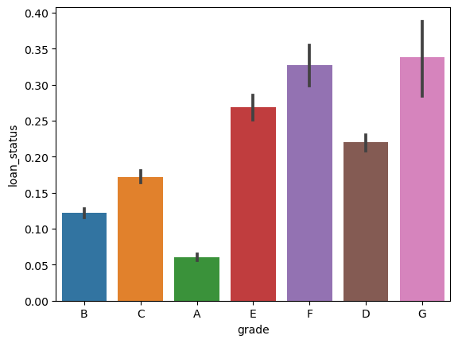
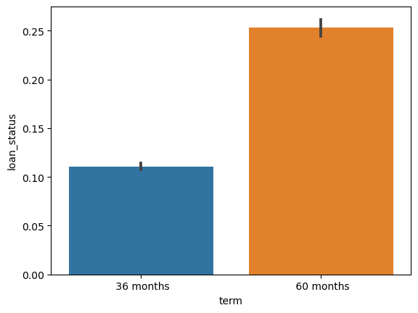
Graph- 2(term vs loan status)
Graph 1(loan status vs grade)
Clearly, as the grade of loan goes from A to G, the default rate increases. This is expected because the grade is decided by Lending Club based on the riskiness of the loan.
here it is see that default rate of 60 months is higher than 36 months

Slide 10
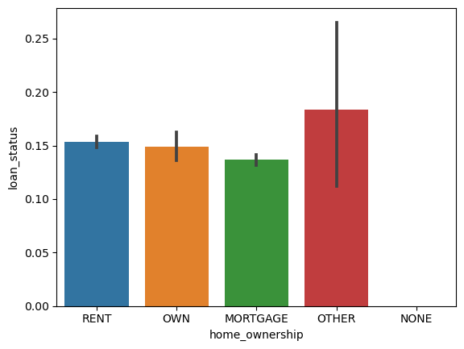
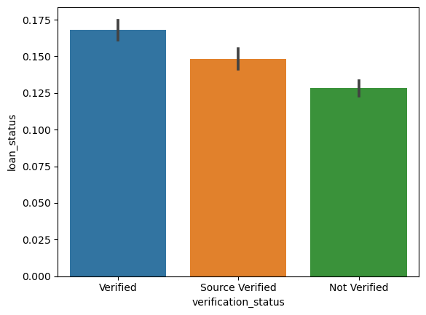
Graph – 3 (home_ownership vs loan status)
Graph-4 (verification status vs loan status)
From above plot for ‘home_ownership’ we can infer that the defaulters rate is constant hence the chances of loan getting defaulted do not depend on home ownership.
From above plot for ‘verification status’ we can infer that the defaulters rate is high for verified loans more than not verified

Slide 11
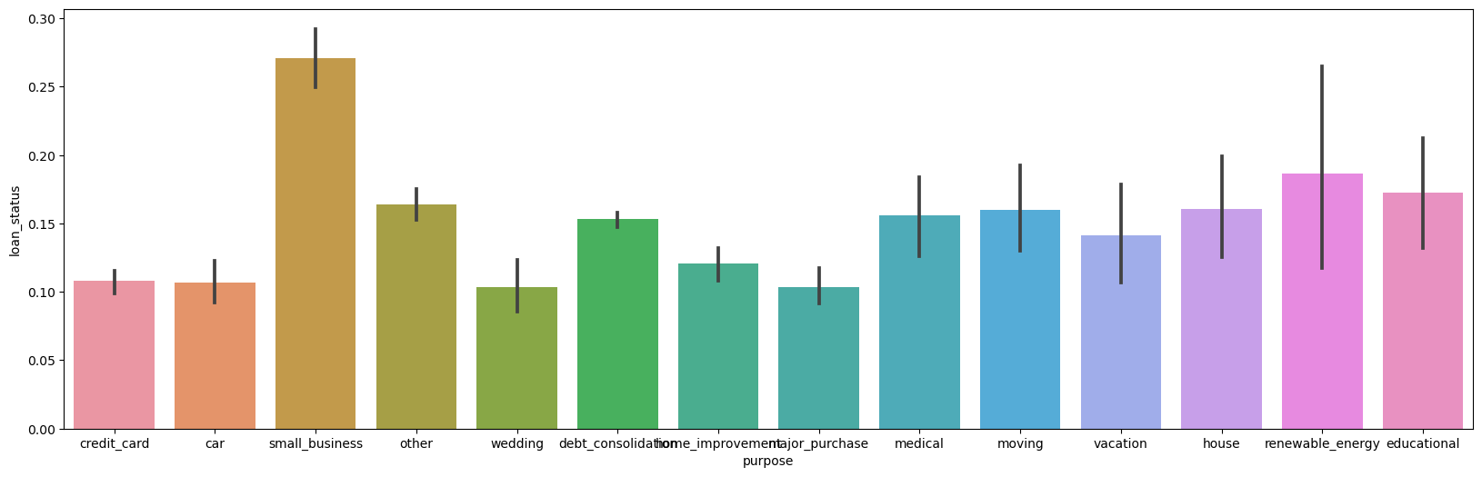
Graph – 5 (purpose vs loan status
From above plot for ‘purpose’ we can infer that the defaulters rate is higher for small business

Slide 12
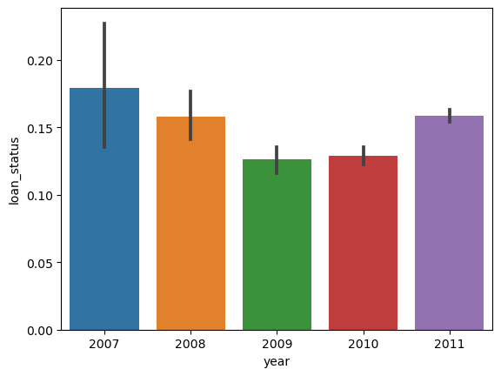
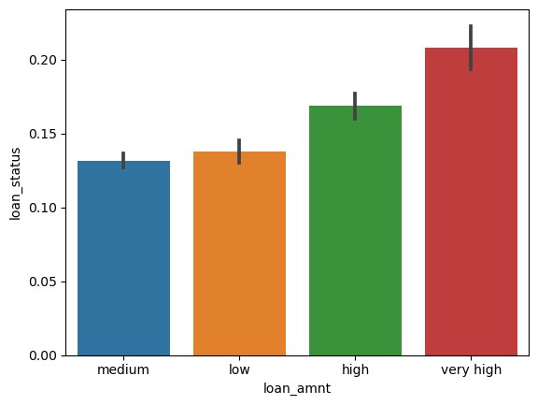
Graph – 6 (year vs loan status)
Graph – 7 (loan amount vs loan status
2007 has high default rate but from 2008-2010 the default rate decreases but there's a sudden increase in default rate in the year 2011
higher the loan amount higher the default rate

Slide 13
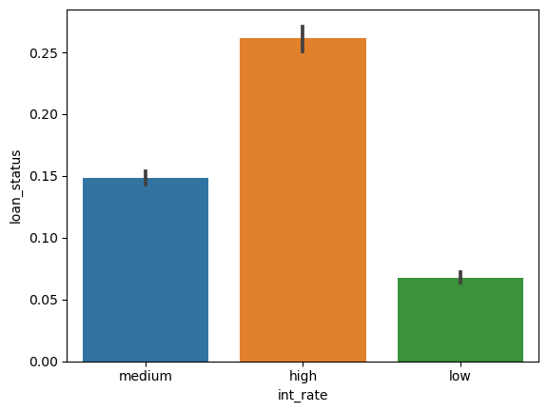
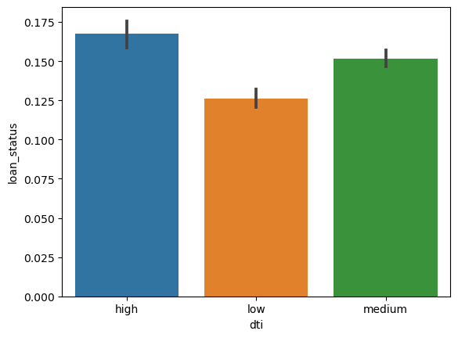
Graph – 3 (interest rate vs loan status)
Graph – 4 ( annual dti vs loan status)
From above plot for ‘int_rate’ we can infer that higher the interest rate higher the default rate
From above plot for ‘dti’ we can infer that the default rate is higher for low dti

Slide 14
MULTIVARIATE ANALYSIS
Multi' means many, and 'variate' means variable. Multivariate analysis refers to the statistical procedure for analyzing the data involving more than two variables. Alternatively, this can be used to analyze the relationship between dependent and independent variables. Multivariate analysis has various applications in clustering, feature selection, root-cause analysis, hypothesis testing, dimensionality reduction, etc.

Slide 15
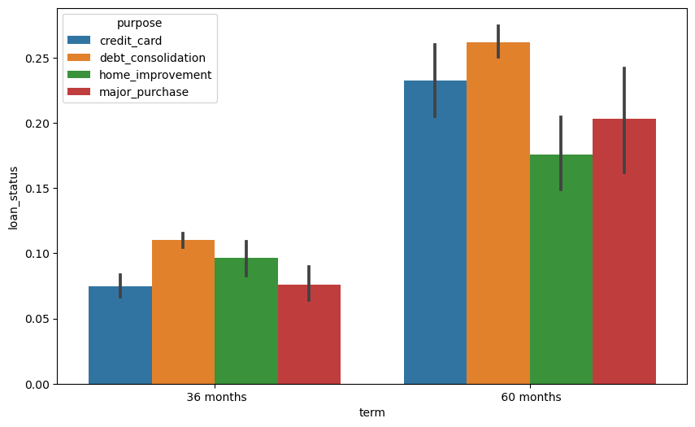
Term vs loan status hue = purpose
compare the default rates across two types of categorical variables
The default rate is low in short term where as the default rate is high in long term and the purpose is also high

Slide 16
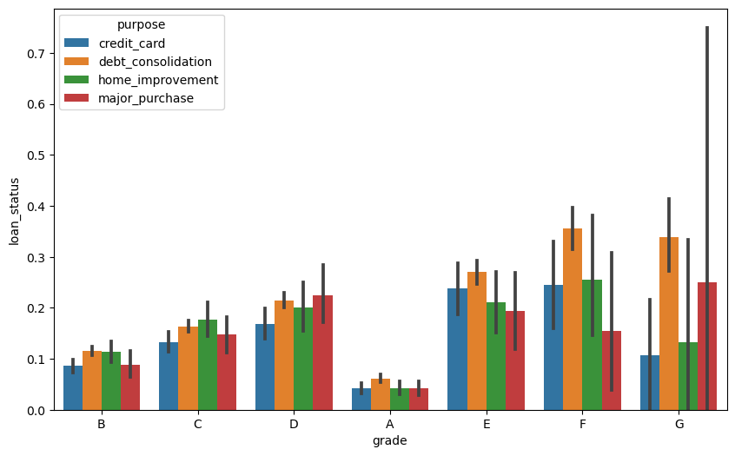
Graph – 3 (grade vs loan status hue=purpose)
From the above graph we can observe that default rate increases for every purpose wrt grade

Slide 17
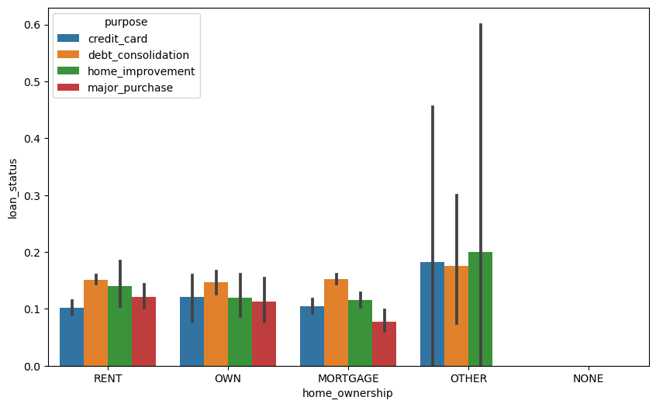
Home_ownership vs loan status hue = purpose
In general, debt consolidation loans have the highest default rates.

Slide 18
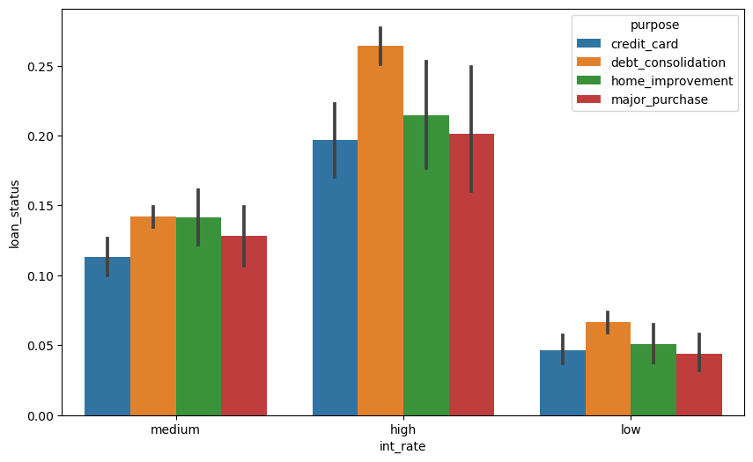
Interest rate vs loan status hue=purpose
from above graph we can see when the interest rate increases with every purpose the default rate also increase

Slide 19


DATA CLEANING AND PREPARATION PROCESS
Removing large null Values cols
Removing duplicate Data
Removing Irrelevant columns
Removing fixing null values
Correcting data type and deriving new columns
Filter Data for requirement
Removing outliers
Importing Data

Slide 20
Data Understanding(Working with the data dictionary and getting knowledge of all the
columns and their domain specific uses)
Univariate analysis(Analyzing each column, plotting the distributions of each column.)
Segmented Univariate analysis(Analyzing the continuous data columns with respect to categorical column)
Bivariate analysis and Multivariate analysis(Analyzing the two variable behavior like loan
amount and loan status
Recommendations(Analyzing all plots and recommendations for reducing the loss of business by detecting columns best which contribute to loan defaulters)

Slide 21
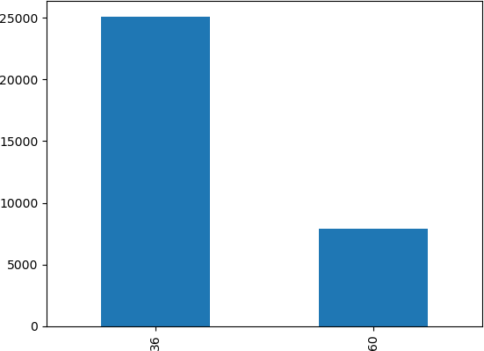
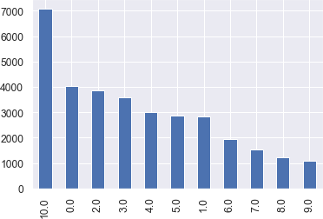
Majority of the employment length of the customers are 10+ years and then in the range of 0-2 years
Majority of the loan applications counts
are in the term of 36 months.
Term
Employment length
'< 1 year': 0, '2 years': 2, '3 years': 3, '7 years': 7, '4 years': 4, '5 years': 5, '1 year': 1, '6
years': 6, '8 years': 8, '9 years': 9, '10+ years': 10})

Slide 22
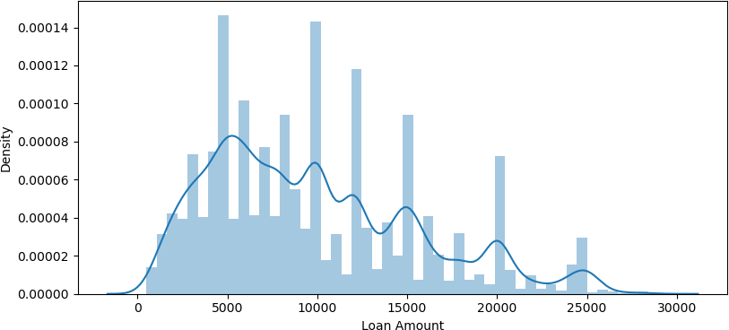
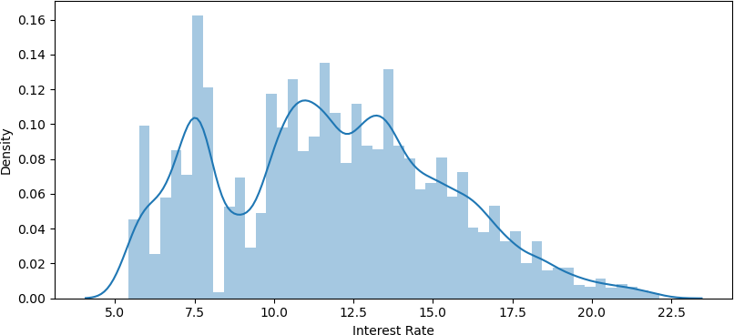
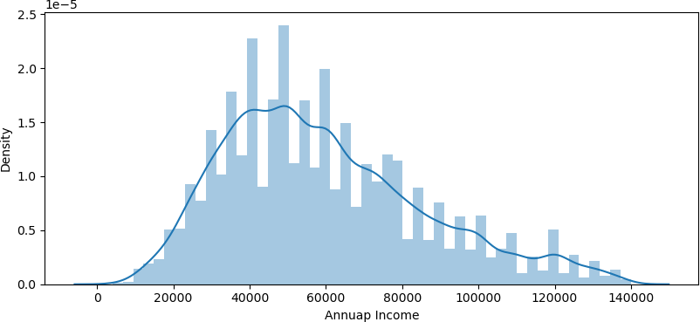
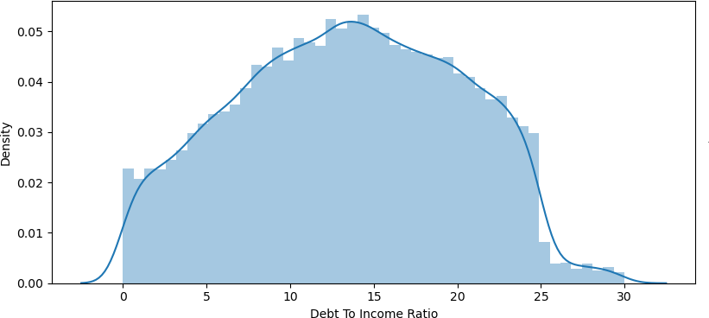
Analysis Of Loan Amount, Interest Rate, Annual Income
Majority of the loan_amount is in the range of 5K to 14K
Majority of the interest rate is in the range of 5% to 16% going
at the max to 22%
Majority of the annual income is in the range of 4k to 40k
going at the max to 120k.
Majority of the debt to income is in the range of 0 to
20 going at the max to 30

Slide 23
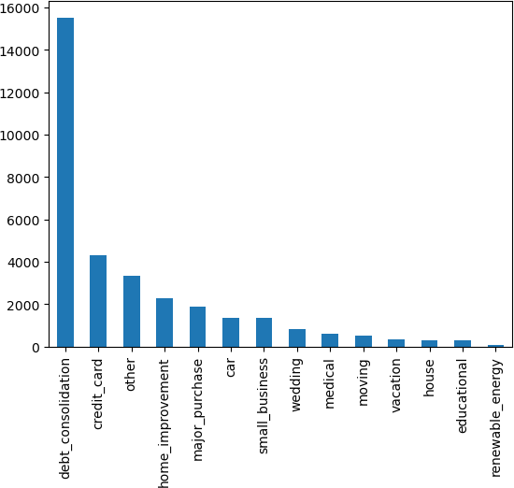
Analysis Of Purpose of Loan
Majority of loan application are in the category of debt_consolidation

Slide 24
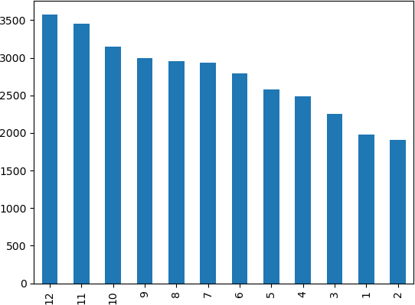
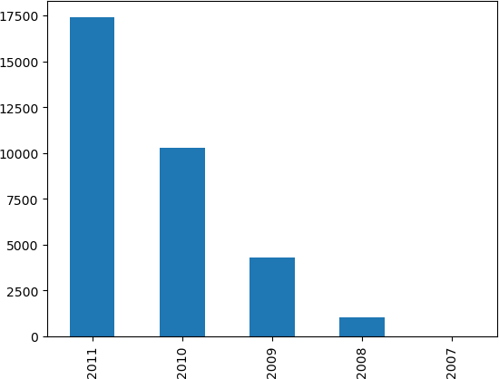
Loan trend over months and years
The lowest loans application count are in the month of Jan/Feb/March and highest counts are in 10/11/12. Possibly because by year ends people face the financial challenges Possibly because of festive seasons Possibly because they are consolidating debt by year end

Slide 25
Univariate Analysis Summary
Customer Demographics
Majority of the loan applicants are in the range of 0 - 40K annual income
Majority of the debt to income is in the range of 0 to 20 going at the max to 30
Majority of the home owner status are in status of RENT and MORTGAGE
Highest loan applications are in the category of debt_consolidation
CA (California) state has the maximum amount of loan applications
Majority of the loan applicants are in the category of not having an public
record of bankruptcies
Majority of the employment length of the customers are 10+ years and then in the range of 0-2 years
Loan Demographics
Highest loan amount applications fall in the range of 5k to 10k
Majority of the interest rate is in the range of 5% to 16% going at the max to 22%
Majority of the installment amount is in the range of 20 to 400
Majority of the loan applications counts are in the term of 36 months
Majority of loan application counts fall under the category of Grade B
Time Based Analysis
Loan application counts are increasing year over year
Highest loan application volume in Quarter 4 of every year
Lowest loan applications are in Q1
Possibly because by year ends people face the financial challenges
Possibly because of festive seasons
Possibly because they are consolidating debt by year end
Inferences
The customer demographic data shows which segment of customers to
target for highest volume of loan
Indicates more analysis is needed why other categories are not as high as other few
Indicates the Lending Club to be prepared with volume in Q4
Indicates the Lending Club to target customers in other quarters to increase
sales

Slide 26
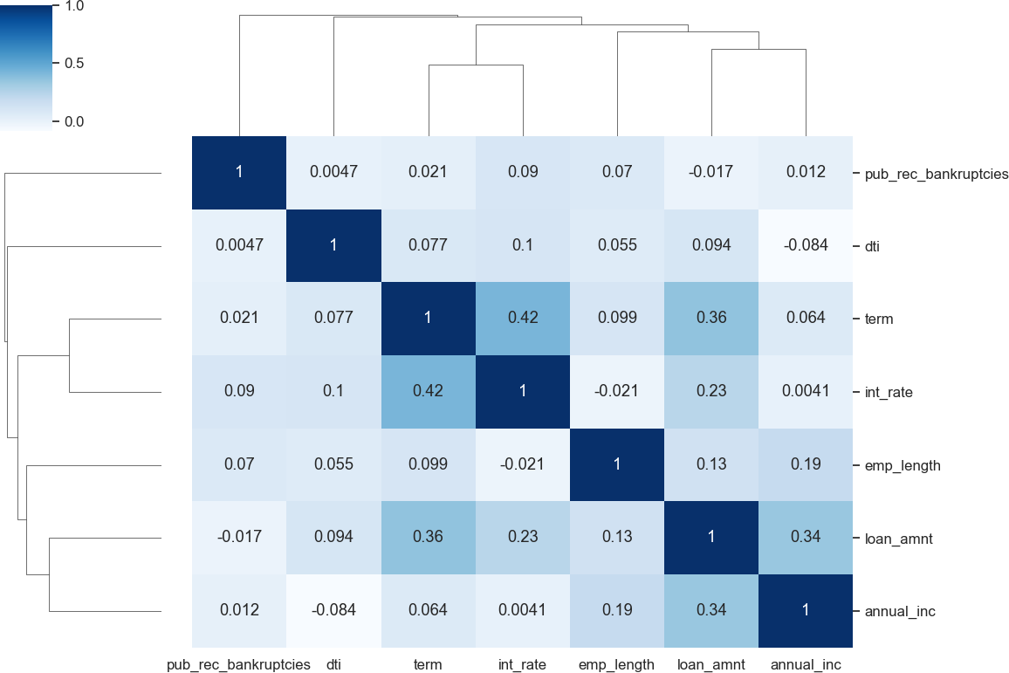
Correlation Analysis
Negative Correlation
loan_amnt has negative correlation with pub_rec_bankrupticies
annual income has a negative correlation
with dti
Strong Correlation
term has a strong correlation with loan amount
term has a strong correlation with interest
rate
annual income has a strong correlation with loan_amount
Weak Correlation
pub_rec_bankruptcies has weak correlation
with most of the fields

Slide 27
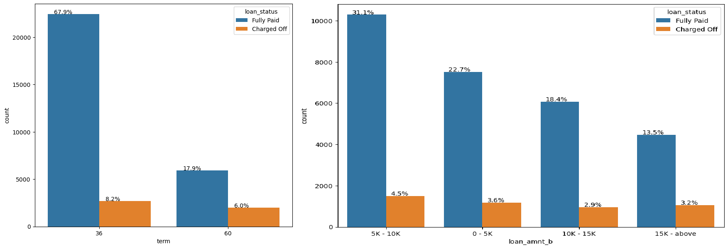
Analysis of Loan Term Vs Loan Status and Loan Amount Vs Loan Status
The volume of loans are in the category of term = 36
The overall percentage of Charge Off's is slightly higher in term = 36 (8%) as compared to term=60 (6%)
If we calculate the ratio of Charge Off's within a category
Charge Offs ratio is for the term=60 is 25% which is much higher than term=36 (10%)
term=60 is the loan applications which require more scrutiny
Inferences
Most of the applicants with term=60 potentially will have high Charge Offs
Based on volume highest percentage of Charge Offs are in the category of 5K to 10k of loan_ammount
The Charge Off ratio of all the customer's within the loan_amount of 15K and above is at the highest Charge Off risk
Inferences
Charge Off risk of loan amount 15K and above is at the highest risk

Slide 28
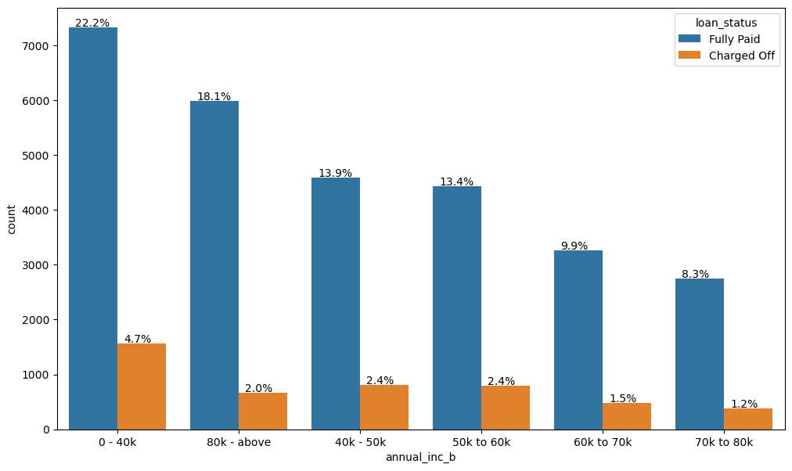
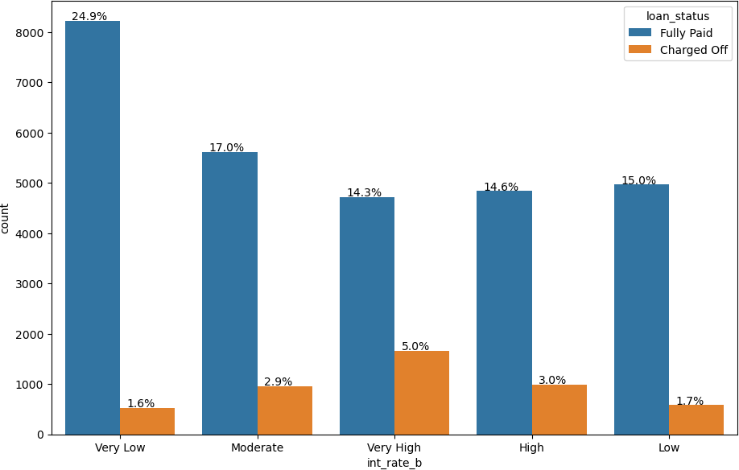
Analysis of Interest Rate Vs Loan Status and Annual Income Vs Loan Status
Annual income range of 0-40K has the highest charge offs
Charge off ratio within the bucket of 0-40K have highest
Charge Offs
Inferences
Income range of 0-40K have the highest risk
Income range 80000+ has less chances of charged off.
Increase in annual income charged off proportion
decreases.
Based on volume and based on Charge Off ratio within the category, the Very High interest rates are in risk of Charge Off
Very High interest rate is 15% and above

Slide 29
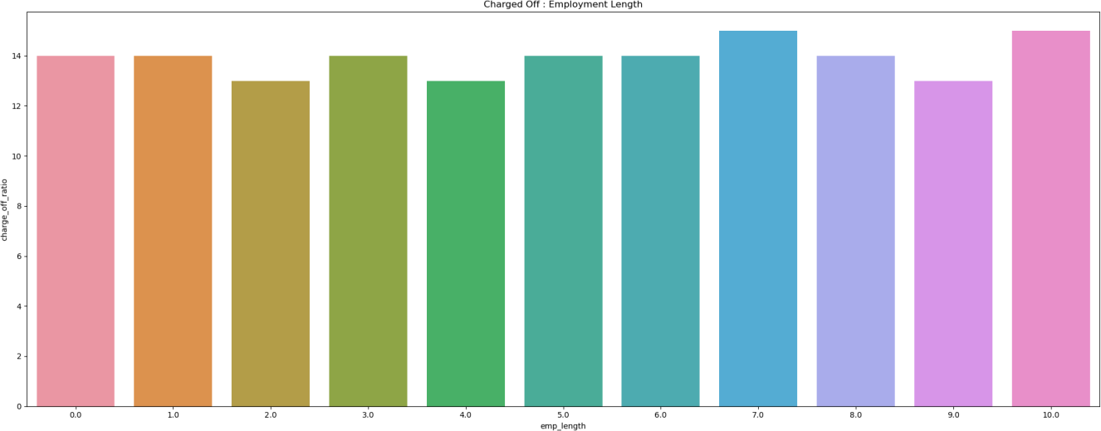
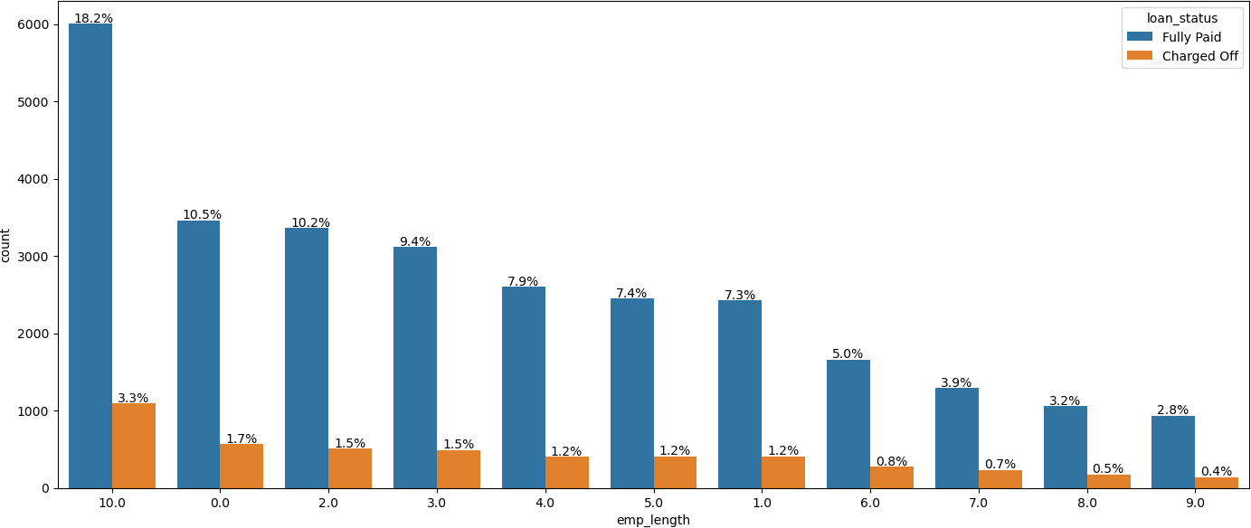
Employment length
Highest Charge Offs are in the employee length category of 10 Years and above Charge Off ratio within the categories itself are similar and inconclusive Inferences Highest Charge Offs are in the employee length of 10 Years and above High probability of Charge Off's whose income range is less than 1 years Ratio within the ranges are pretty much same (in conclusive)

Slide 30
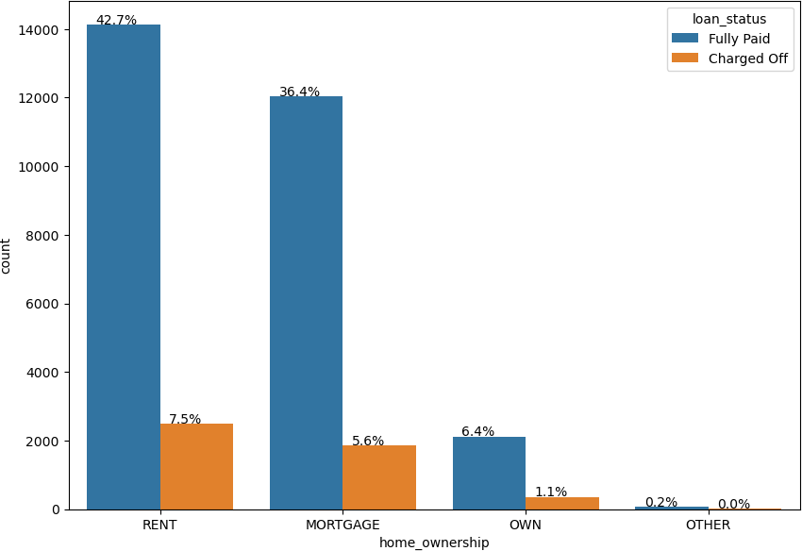
Analysis on Home ownership
Overall highest Charge Off numbers are in the category of RENT and MORTGAGE
Within each homeownership category the ratio of Charge Off's for Other is higher
Inferences
The home_ownership status of MORTGAGE and are at the highest risk of Charge Offs
MORTGAGE status also has the highest range of loan amounts increasing the risk

Slide 31
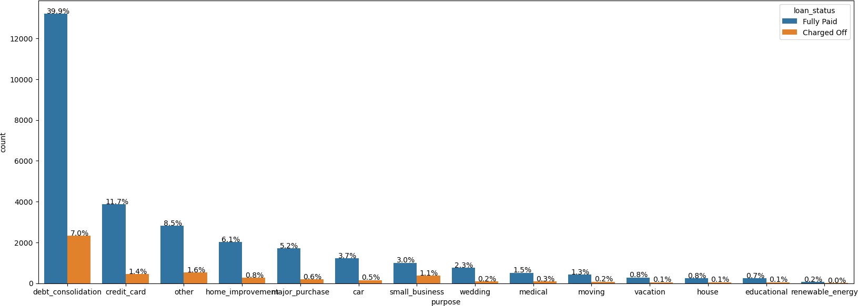
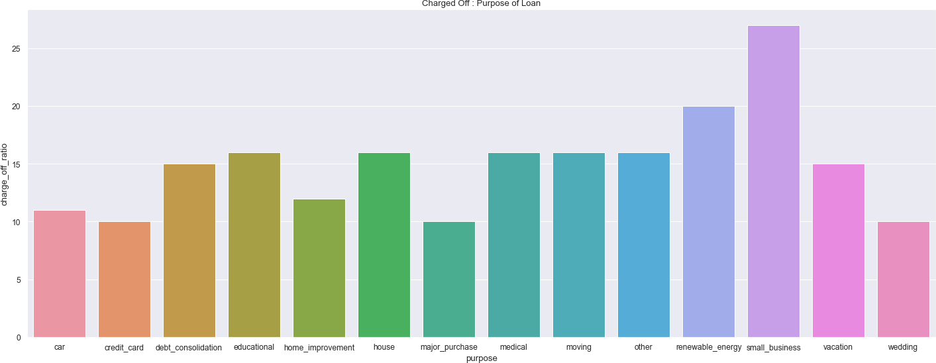
Analysis of probability of applicant default for small business
Highest risk of Charge Offs are the category of debt_consolidation
Highest probability of Charge Offs within a category are small business but the volume is extremely low
Highest loan amount ranges are in small business, debt consolidation and house
Inferences
Highest risk of Charge Off's are the purpose of debt_consolidation
Small Business applicants have high chances of getting charged off.
renewable energy has lowest risk of Charge Off's in volume

Slide 32
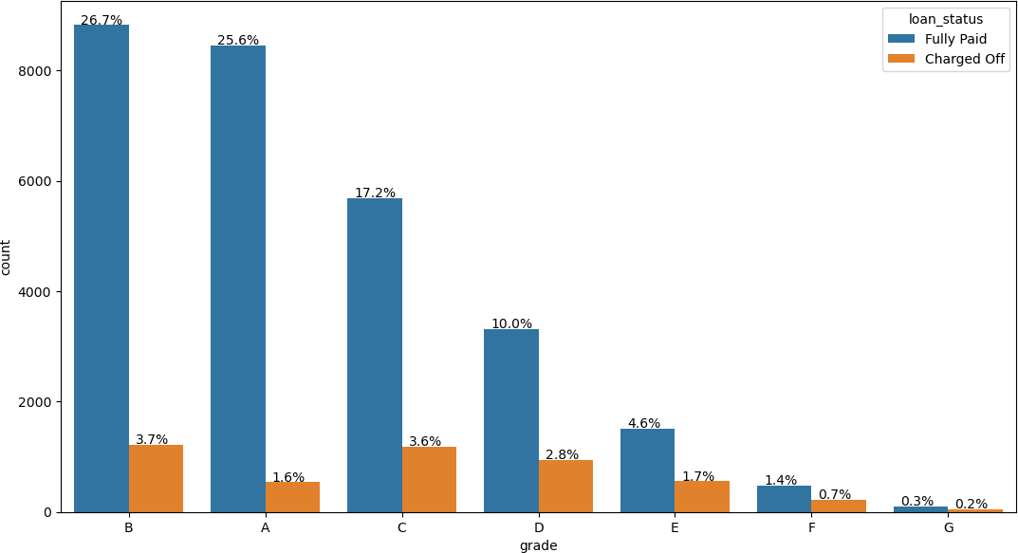
Analysis on Grade sector
The Majority of loan volume is in grade=B Highest percentage of overall Charge Offs are in grade B (3.7%) and C(3.6%) If we analyze the Charge Off Ratio within a category The highest percentage of Charge Offs are in the grade=G Highest cluster of Charge Offs are in the grades G,F (> 30%) The volume of Grade G is extremely low 158 thus it does not contribute to overall risk significantly Inferences Highest risk of charge off's are in the grades of B and C Grade "F" and "G" have very high chances of charged off. The columns are low Grade "A" has very less chances of charged off. Probability of charged off is increasing from "A" to "G"
Majority of loan application counts fall under the category of Grade B followed by Grade A and Grade C

Slide 33
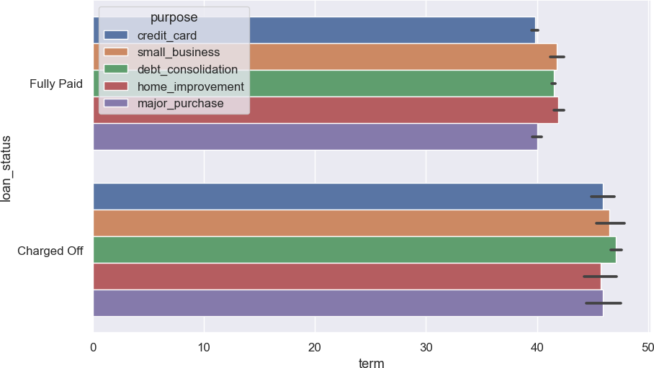
Analysis of Term Vs Loan Amount Vs Purpose for Charged off Loans
More number of applicants have taken a duration of 60 months period for small period
Higher the interest rate, higher is the loan default
Applicants who have taken a very high interest (>= 14%) rates are bound to default more.

Slide 34
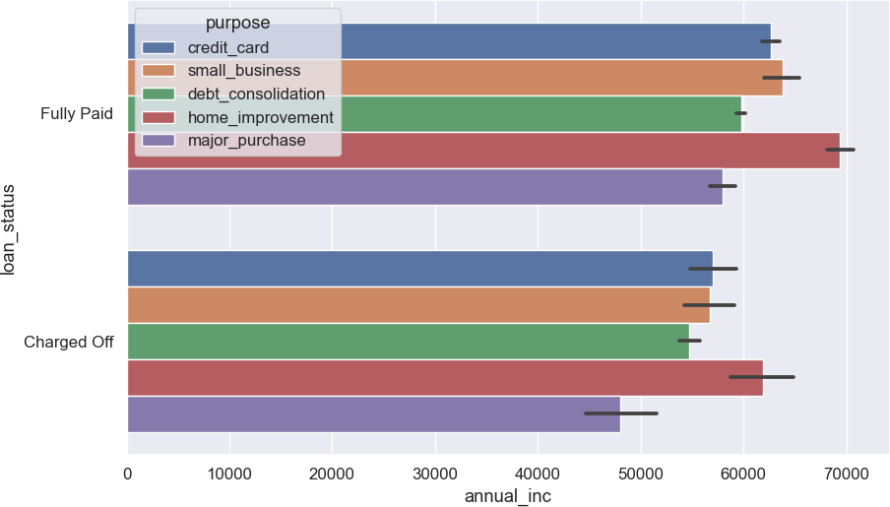
Analysis of probability of applicant default based on annual income
Number of applicants who have taken loan for small business is more across various annual income group. However, applicants under the category of high income
have taken more loan for debt consolidation followed by small business.
Default rate is highest amongst the low annual income (17.38%) group i.e. whose annual income is < 41000 USD per annum.

Slide 35
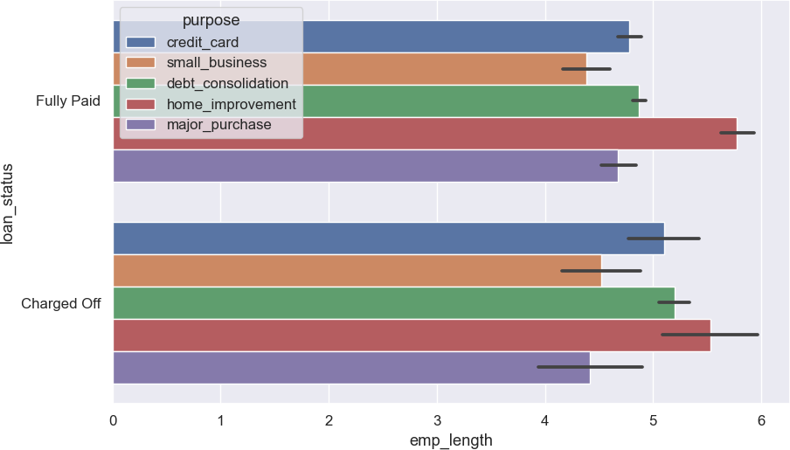
Analysis of probability of applicant default based on Employment length
Following can be inferred from the below plots:
There are more number of applicants who have taken loan for small business across all the employment length group.
Applicants in the Junior level i.e. with a tenure of around 2 to 4 years are a safe bet for giving loans as they do not seem to be defaulting much.

Slide 36
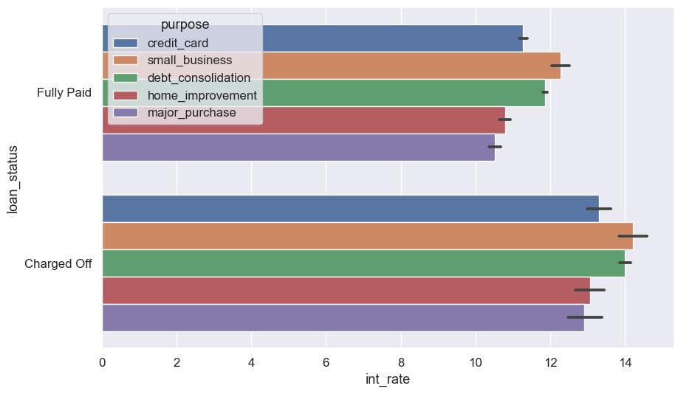


Slide 37
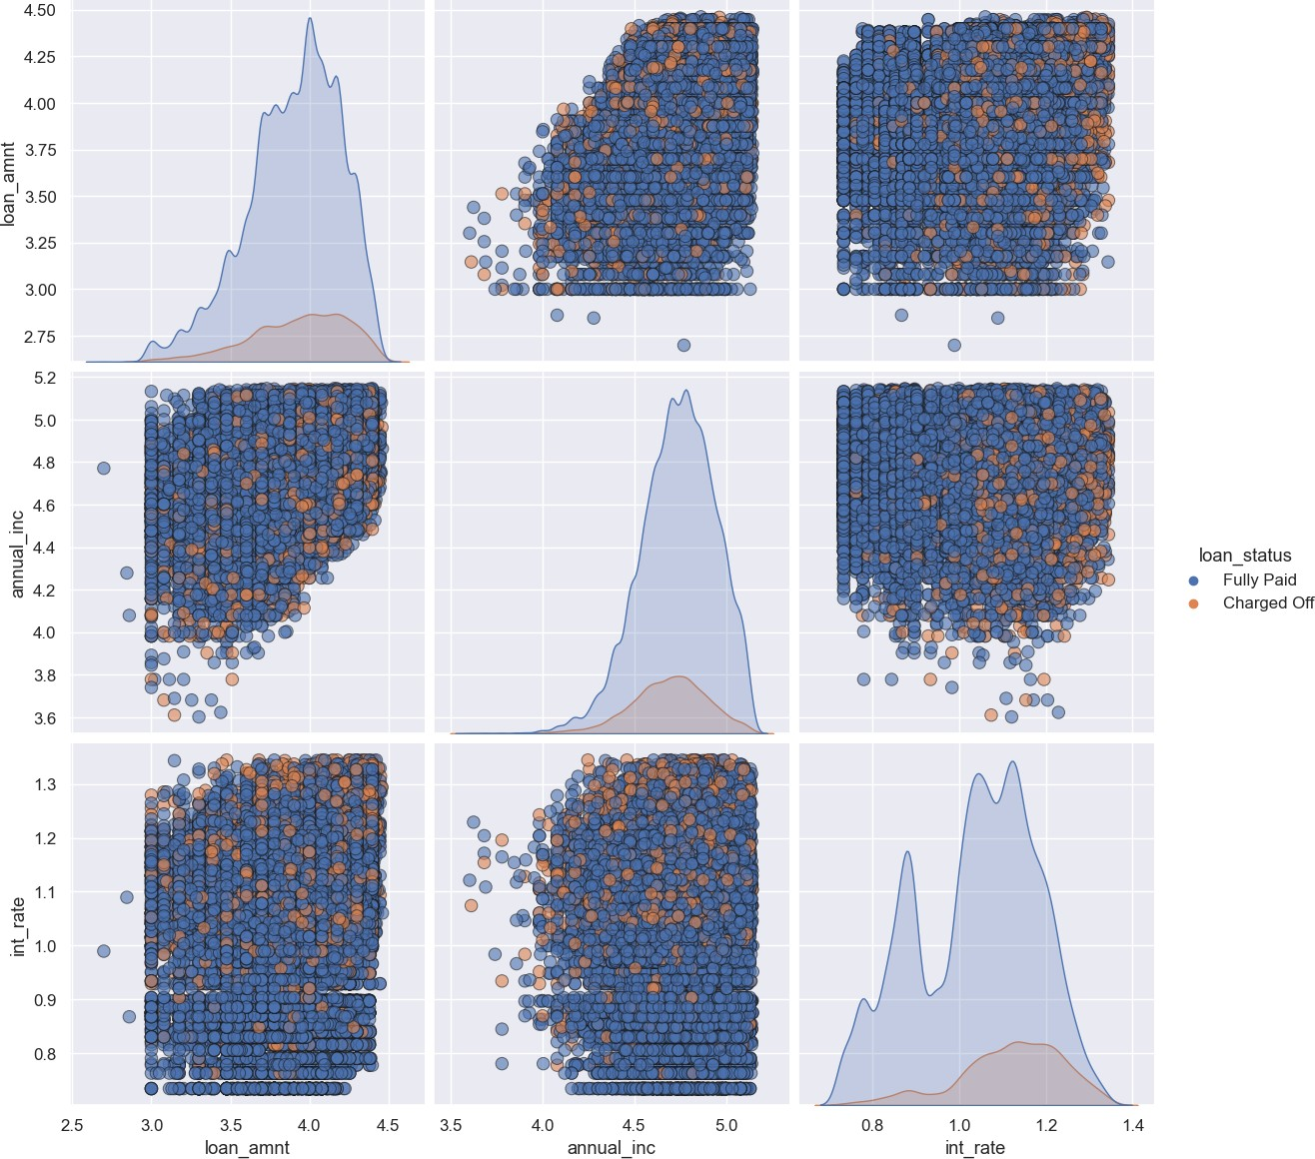
Multivariate Analysis
Observation:
Higher the interest rate higher charged off ratio #
Higher the annual income higher the loan amount slightly.
increase in number of charged off with increase in year.
interest rate is increasing with loan amount increase

Slide 38
Conclusion
Following are the main parameters, taken into consideration for arriving at the analysis conclusion. Loan Status and Loan amount have been compared with the below parameters to arrive at the analysis conclusion
Purpose for which the loan is taken
Annual Income of the loan applicants
Loan duration (term)
Grade allocated by the LC
Employment Length of the loan applicants
Interest Rate of the loan amount
As per the analysis, it can be inferred that applicants who are of low income group and have taken a high interest loan with longer duration for small business have more probability of defaulting. Hence extra care should be taken before lending them loans.
Lending club should reduce the high interest loans for 60 months tenure, they are prone to loan fault.
Grades are good Metrix for detecting defaulters. Lending club should examine more information from borrowers before issuing loans to Low grade (G to A). Lending club should properly analyze, the applicants demanding higher loan. Lending club is approving loan of applicants mostly in high grades which is good but they still need to be more cautious when approving loans for lower grade as lower grades has more than 25% chances of defaults and also we are charging high interest rates in lower grades which can also promote the chances of defaults in lower grades
Low grade loans have high tendency to default. Grading system is working as expected. Loans having higher interest rate have more defaulters. Check the background of applicant thoroughly if interest rate is high.
Lending Club before approving loan should take a look at the DTI(Debt to Income ratio) of the applicants. As DTI of borrowers increases their tendency of defaults also increases Applicants with more revolving utilization rate tends to default more, borrowers having revolving credit utilization rate more than 80% has more than 20% chances of defaults Lending club should be more conscious when approving loans for applicants in the lower annual income segment, borrowers having annual income in range of 0-50k has more than 15% chances of defaults High loan amounts has more chances of Charge-offs(more than 20% for loans amounts greater than 30k),.
Lending club should be more cautious when approving loan for the purpose of Small business, Debt consolidation and Credit card Borrowers having home ownership as 'Rent' and 'Mortgage' has higher chances of defaults

